Slide 1


WEATHER FORECAST FOR IRRIGATION USING
DATA MINING
TEAM MEMBERS:
CHHAVI (RA2011003020612)
SUBIKSHA (RA2011003020589)
RIYA MARTIN (RA2011003020590)
BATCH 15
Semester 5
3rd Year
Ms. Aarthi.B,AP/CSE
Ms.K Ramiya, AP/CSE

Slide 2

ABSTRACT
Weather forecasting is the application of science and technology to predict the conditions of the atmosphere for a given location and time. Data is first calculated by scanning current atmospheric reading such as barometer readings, and future forecasts are predicted from the existing data.
Weather predictions are important to our daily life. Forecasts based on temperature and precipitation are important to agriculture, and in turn its market and consumers. People check up on the weather forecast to plan their day ahead depending on if it rains.

Slide 3
ABSTRACT
Our team plans to mine data from a site where the weather forecast of various countries are displayed and updated frequently. The user of our program may use filters to view particular weather conditions in particular countries.
Data mining can be done using Python, and there are various data mining tools available:
Weka
Orange
MonkeyLearn
RapidMiner

Slide 4
INTRODUCTION
Farming factors involve soil, irrigational facilities, and other farming tools and techniques too. Apart from the mentioned factors weather forecasting is an important factor that farmers need to take into consideration too. Temperature plays a vital role in the growth of numerous fruits, vegetables, and legumes. Farmers had to rely on forecasts to fulfil their duties because we didn't have a better understanding of weather forecasting earlier.
This is why our team decided to create a program to forecast the weather of any city at any time. The program is easy to use and people who are not tech-savvy are able to use it easily. Farmers may now get all their updates on their smartphones, thanks to advances in technology and the availability of advanced weather forecasting mechanisms.

Slide 5
OBJECTIVE
One of the most difficult scientific and technical problems in the world is weather forecasting, a crucial application of meteorology.
Our project aims to forecast weather by the means of data mining and analysis algorithms.

Slide 6

SCOPE
As India is an agricultural country, a large amount of our population depends on the monsoon season. Thus it becomes a matter of concern for the scientists to exactly forecast and predict the weather conditions.
One of the biggest challenges in weather forecasting is unpredictable and dynamic data sets, which can frequently change according to global climatic changes. The main objective is to identify the hidden information from the given data set.
Data mining can uncover hidden relationships and patterns as well as verify/validate data sets based on specific input requirements.

Slide 7
PROBLEM STATEMENT
Our project aims to forecast weather by the means of data mining and analysis algorithms. We also added a feature to assist farmers in irrigation with respect to the weather. This way, the program will be efficient in solving problems related to weather forecasting and irrigation.
.

Slide 8

LITERATURE SURVEY
S. No. | Paper Name | Author/Year/Publisher | Algorithm | Limitations
1. | A Comparative Analysis of Data Mining Methods for Weather Prediction | Mohammad Zeyad, Md Sajid Hossain/2021/IEEE | Bayes's theorem, Artificial Neural Networks, classification and clustering models | The accuracy initially increases, but subsequently decreases after a specific limit is reached. Weather forecasting may be more accurate by using a variety of data mining approaches that may be used in real-time.
2. | Critical Review of Data Mining Techniques in Weather Forecasting | Sara khan, Mohd Muqeem, Nashra Javed/2016/IJARCCE | Clustering techniques, Pattern representation, Use of Decision Tree Network | One of the major concerns of Weather prediction is its Accuracy and its Timely output. Requires complex problem domain, give most accurate results and has higher evaluation speed.
3. | The Weather Forecast Using Data Mining Research Based on Cloud Computing | ZhanJie Wang and A. B. M. Mazharul Mujib/2017/IOP Publishing | Artificial Neural Networks (ANN) and Decision Trees (DT), Data Abstraction | Needs extensive amounts of data to produce a result, one error in data results in chain errors

Slide 9
LITERATURE SURVEY
S. No. | Paper Name | Author/Year/Publisher | Algorithm | Limitations
4. | A Real-Time Weather Forecasting and Analysis | Sushmitha Kothapalli, S. G. Totad /(ICPCSI-2017)/IEEE ,Signals and Instrumentation Engineering | The raspberry pi is used for storing the collected data to the cloud, ARIMA model, Cloud, Correlation, Raspberry Pi, Time-series data. | Only first two successive years give accurate results in prediction of future weather values, because of the standard error values as the year’s increases
5. | Prediction of Rainfall Using Data Mining Techniques | VP Tharun,Ramaya Prakaash,S. Renuga devi/2018/IEEE | Support Vector Regression (SVR), Random forest (RF) and Decision Tree (DT) | One of the major concerns of Weather prediction is its Accuracy and its Timely output. Requires complex problem domain, give most accurate results and has higher evaluation speed.
6. | Weather Prediction Using Data Mining | Prashant Biradar, Sarfraz Ansari, Yashavant Paradkar, Savita Lohiya/2017/IJEDR | Naive Bayes,K- Medoids | Needs extensive amounts of data to produce a result, one error in data results in chain errors

Slide 10
LITERATURE SURVEY
S. No. | Paper Name | Author/Year/Publisher | Algorithm | Limitations
7. | Weather Forecast Prediction: An Integrated Approach for Analyzing and Measuring Weather Data | Munmun Biswas,Tanni Dhoom,Sayantanu Barua/2018/IJOCA | classifier approach, Naive Bayes and Chi square algorithm | Relationships may appear to be significant when they aren't simply because a very large sample is used. In addition, the chi-square test cannot establish whether one variable has a causal relationship with another.
8. | Weather Forecasting Model using Artificial Neural Network | Kumar Abhisheka , M.P.Singha , Saswata Ghoshb , Abhishek Anandc /2012/C3IT | Artificial Neural Network | Artificial Neural Networks require lots of computational power. Neural network models are hard to explain. Neural network training requires lots of data. Data preparation for neural network models needs careful attention.
9. | Weather Webapp Using Reactjs And Weather API | Joy Sharma, Afzal Khan, Nirban Kaif , Bhavesh Mishra, Mrs. Poonam Vengulekar/ 2022/IJRASET43178 | Reactjs, Weather API | APIs are vulnerable to man-in-the-middle attacks

Slide 11
LITERATURE SURVEY
S. No. | Paper Name | Author/Year/Publisher | Algorithm | Limitations
10. | Weather Data Forecast and Analytics | Vishal D. Wavhale, Vivek Kumar, Vidit Raj Choudhar/2020/IRJET | AWS Lambda, | Requires complex problem domain, give most accurate results and has higher evaluation speed.

Slide 12

EXISTING SYSTEM PROBLEM
Previously, the farmers had to rely on their own predictions of the weather. They practiced sky gazing- if the sky had clouds, it was their indication of rain. They also relied on the seasonal change.
People could not exactly predict all the precise details of the weather: that is thunderstorms, time period of rain, amount of precipitation, etc. Therefore an accurate weather forecast is duly required.

Slide 13
PROPOSED SYSTEM
With the program we are developing, it is extremely efficient to check the weather forecast. Farmers can even predict the weather for days in the future, even specifics.
This is very valuable as farmers and plantation owners closely watch the weather as even one foresight could ruin their crops. Thus our weather forecast provides features such as precise predictions of rainfall, sunny weather, cloudy, thunderstorms. This information is helpful for the farmers as they can plan accordingly.

Slide 14
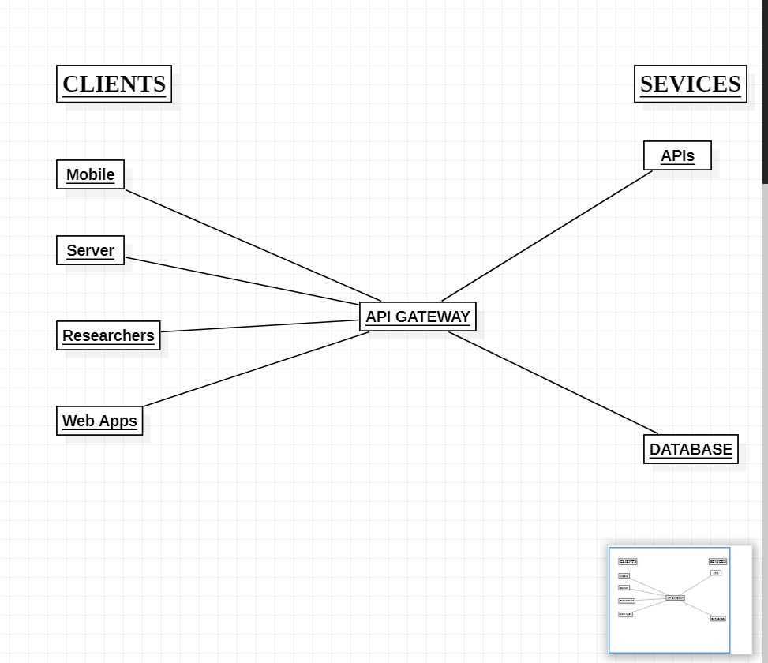
ARCHITECTURE DIAGRAM

Slide 15
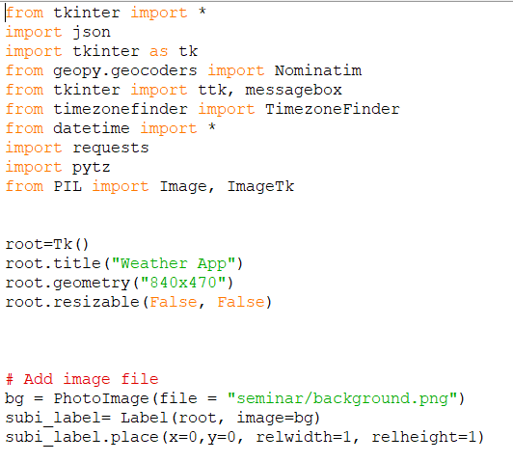
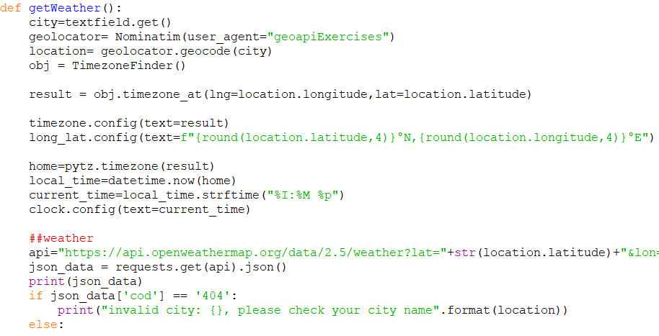
MODULE CODE

Slide 16
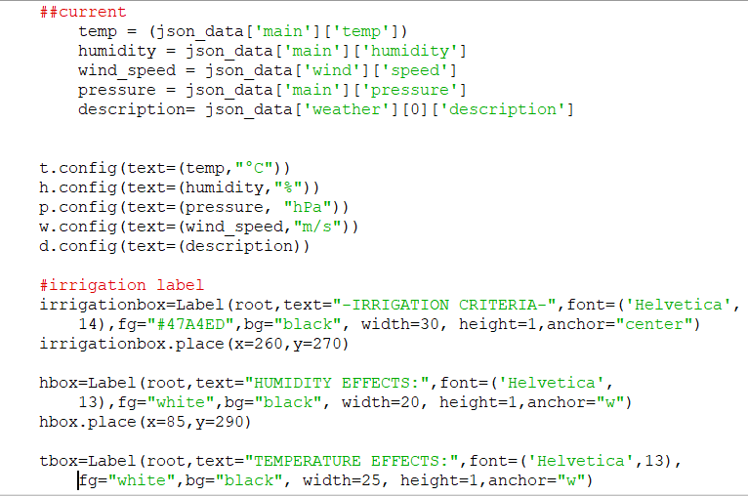
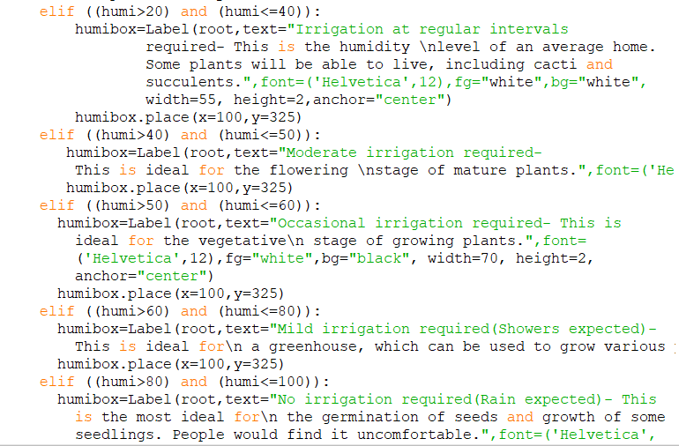
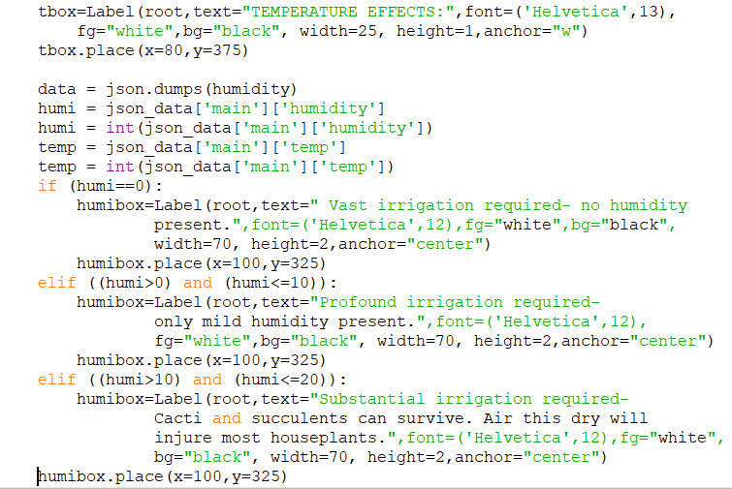
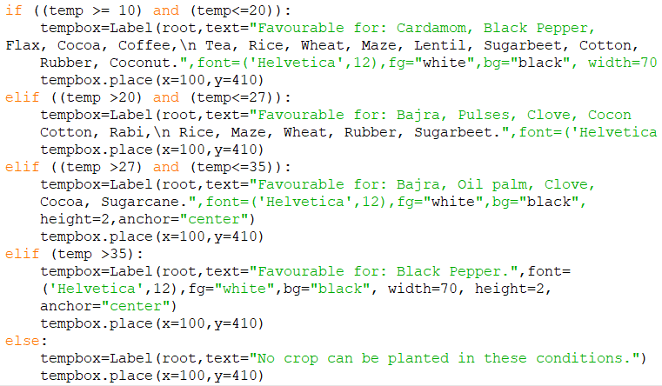
MODULE CODE

Slide 17
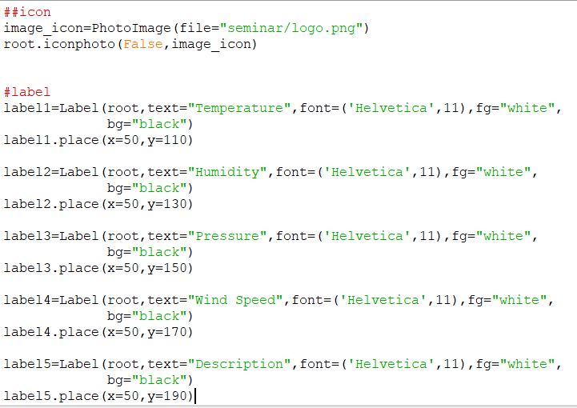
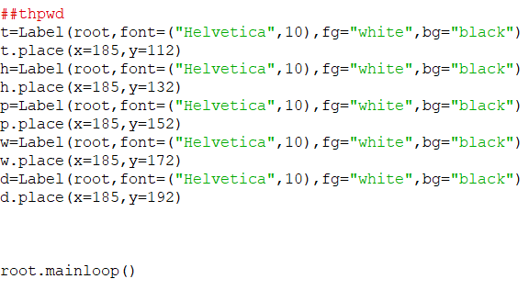
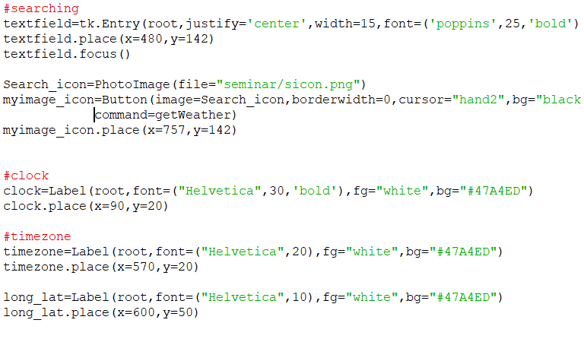
MODULE CODE

Slide 18
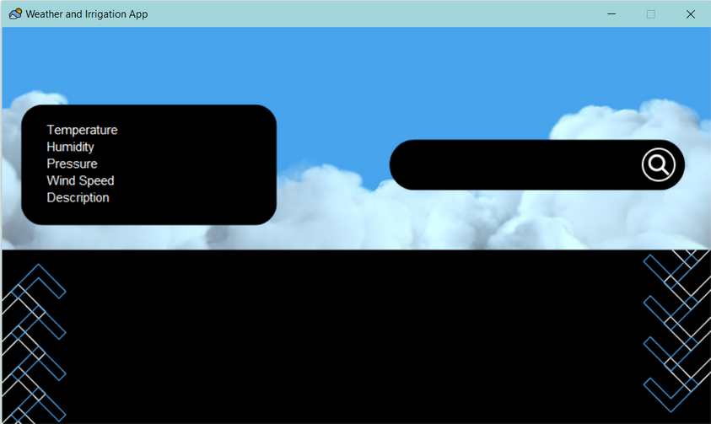
MODULE IMPLEMENTATION

Slide 19
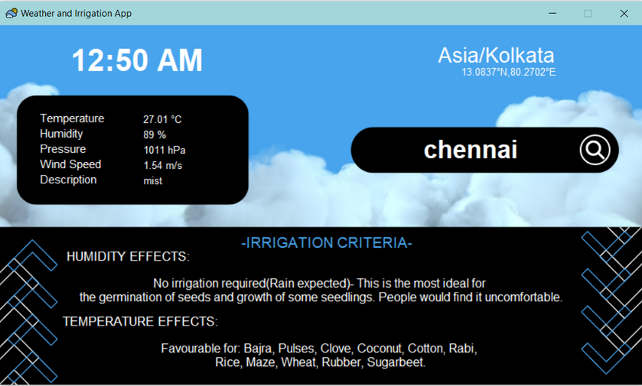
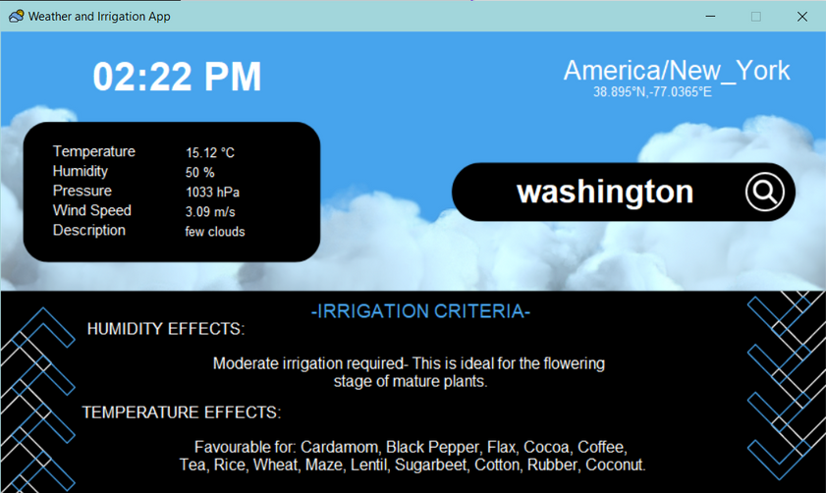
MODULE IMPLEMENTATION

Slide 20

CONCLUSION
The program that can accurately provide weather forecast data on any city, and give irrigation information base on humidity and temperature readings in that area has been made. In future versions the program can be further enhanced by upgrading the account and allowing more use of the API codes .According to audience reception and usage, we can even expand the weather forecast service by providing:
Historical weather data
Solar radiation data
Global weather alerts via push notification
Road risk data

Slide 21
REFERENCES
2021 International Conference on Computational Performance Evaluation (ComPE) North-Eastern Hill University, Shillong, Meghalaya, India. Dec 1-3, 2021
(A Comparative Analysis of Data Mining Methods for Weather Prediction)
International Journal of Advanced Research in Computer and Communication Engineering Vol. 5, Issue 4, April 2016
(A Critical Review of Data Mining Techniques in Weather Forecasting )
IOP Conf. Series: Journal of Physics: Conf. Series 910 (2017) 012020 doi :10.1088/1742-6596/910/1/012020
(The Weather Forecast Using Data Mining Research Based on Cloud Computing.)

Slide 22
REFERENCES
(API 2.5)https://api.openweathermap.org/data/2.5/weather
(The bet humidity level for plants) https://greenupside.com/what-is-the-best-humidity-level-for-plants/#:~:text=An%20ideal%20humidity%20range%20for,can%20tolerate%20lower%20humidity%20levels
(List of Major crops and required Geo-climatic condition across the world) https://www.jagranjosh.com/general-knowledge/list-of-major-crops-and-required-geoclimatic-condition-across-the-world-1488802282-1

